Slide 1


Slide 2
LEARNING ENGLISH BY STUDYING IDIOMS
Supervised by:
Professor Sahar Hashemi
Students:
Mahak Hosseini
Soroush Rezaei jam
Matin Hasoomi
Seyyed-Hossein Ghattali
Submitted: 2026/5/5
University of Tehran

Slide 3
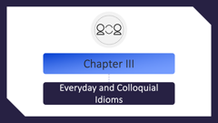
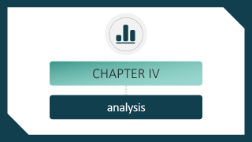

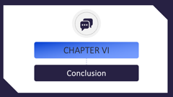
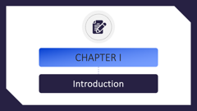

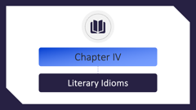

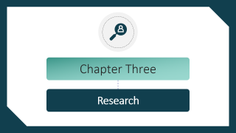
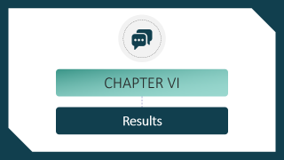
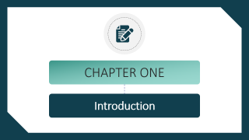

List of contents

Slide 4

CHAPTER I
Introduction

Slide 5

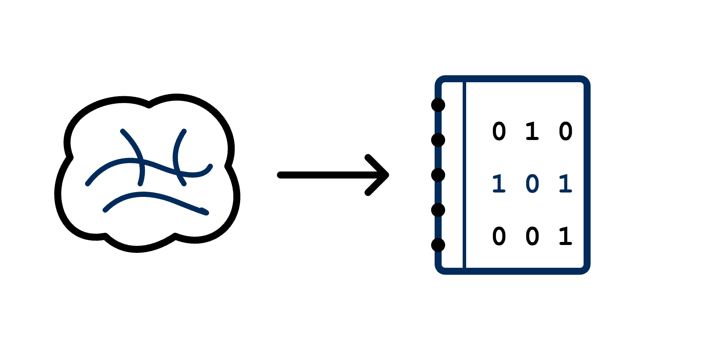
Language = A Codebook !?
A shared codebook is the key to true communication;
Fluency means having the same codes.

Slide 6


The Missing Piece
Beyond the Basics
Grammar and vocabulary build the foundation, but idioms are the essential missing piece;
Idioms complete your language puzzle by adding cultural nuance and natural flow.

Slide 7

An Amazing Shot
A good speech should be concise enough to hold the audience’s attention.
Several sentences to make the point
The right Idiom
yet comprehensive enough to cover the essentials.
-Winston Churchill

Slide 8

Chapter II
Historical Idioms

Slide 9


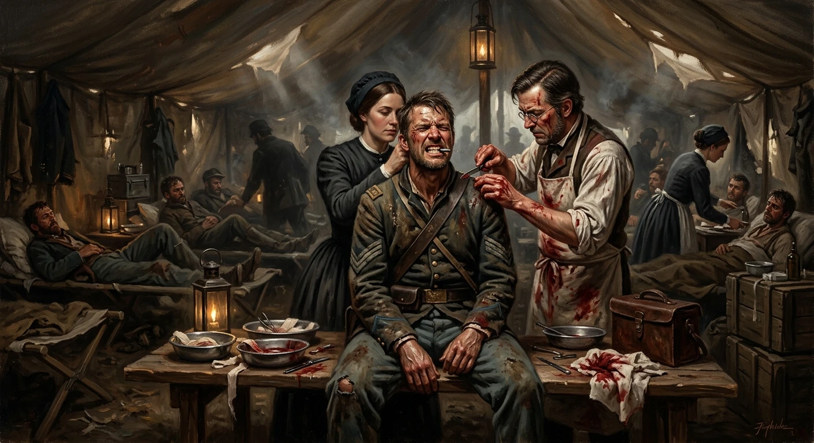


Idiom I
Bite the bullet
The company had to “bite the bullet” and lay off some employees to survive.
. A soldier bites a lead bullet to endure the pain of surgery on a 19th-century battlefield.

Slide 10





Idiom II
Idiom II
Turn a blind eye
You can’t just turn a blind eye to the bullying happening in your world.
. Admiral Nelson using his blind eye to ignore a signal to retreat at the Battle of Copenhagen (1801).

Slide 11


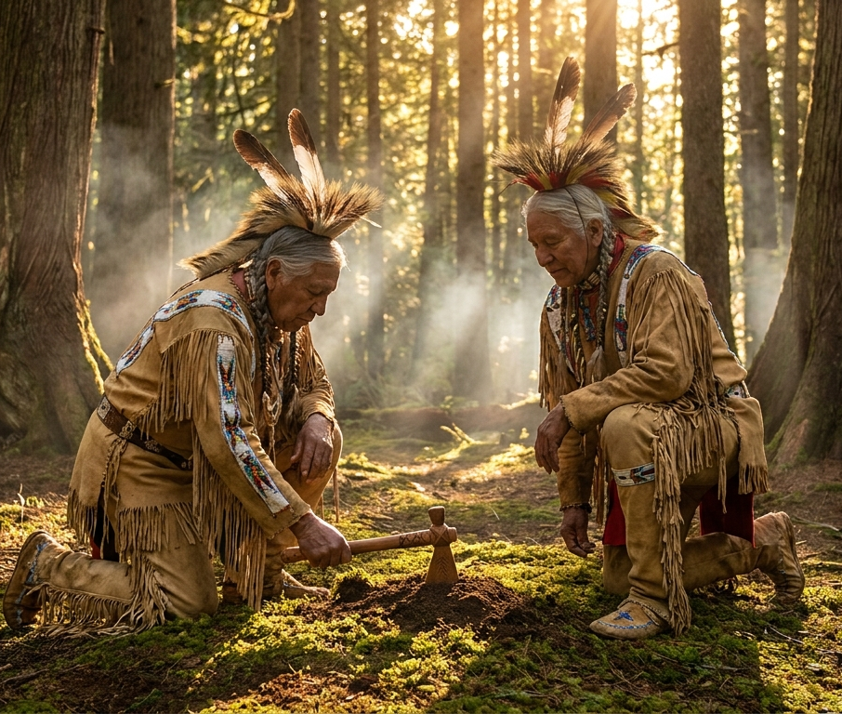


Idiom III
Enter your title slide
Idiom II
Bury the hatchet
Let’s bury the hatchet and forget about our argument yesterday.
. Native American chiefs burying a tomahawk as a symbolic gesture of peace between their tribes.

Slide 12





Enter your title slide
Idiom IV
Enter your title slide
Idiom II
Show your true colors
When the team started losing, the captain showed his true colors by blaming everyone else.
. Pirate ships often flew false flags to deceive vessels before revealing their ‘true colors’ and attacking.

Slide 13

Chapter III
Everyday and Colloquial Idioms

Slide 14
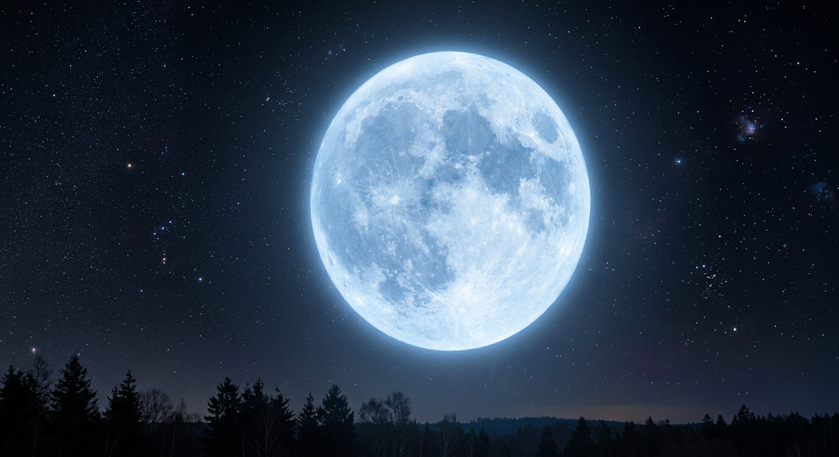
Everyday and colloquial idioms
Once in a blue moon
My brother lives in another country , so I only see him once in a blue moon.
Origin: This is a scientific term.
A “Blue Moon” is the second full moon in a single calendar month.
This phenomenon is very rare, occurring only once every 2 or 3 years.
Thus, the phrase is used for things that happen very seldom.

Slide 15

Everyday and colloquial idioms
Kill two birds with one stone
I’ll drop you at the airport on my way to work, so I can kill two birds with one stone.
Origin: This idiom likely dates back to Ancient Greek mythology or old hunting practices, where a single stone could be used to hit two targets.

Slide 16

Everyday and colloquial idioms
Cost an arm and a leg
I’d love to buy that car, but it costs an arm and a leg.
Origin: Two popular theories exist:
1. In the past, famous painters charged more to include limbs (arms and legs) in portraits.
2. After World War I, soldiers who lost limbs paid a “heavy price” for their service.

Slide 17
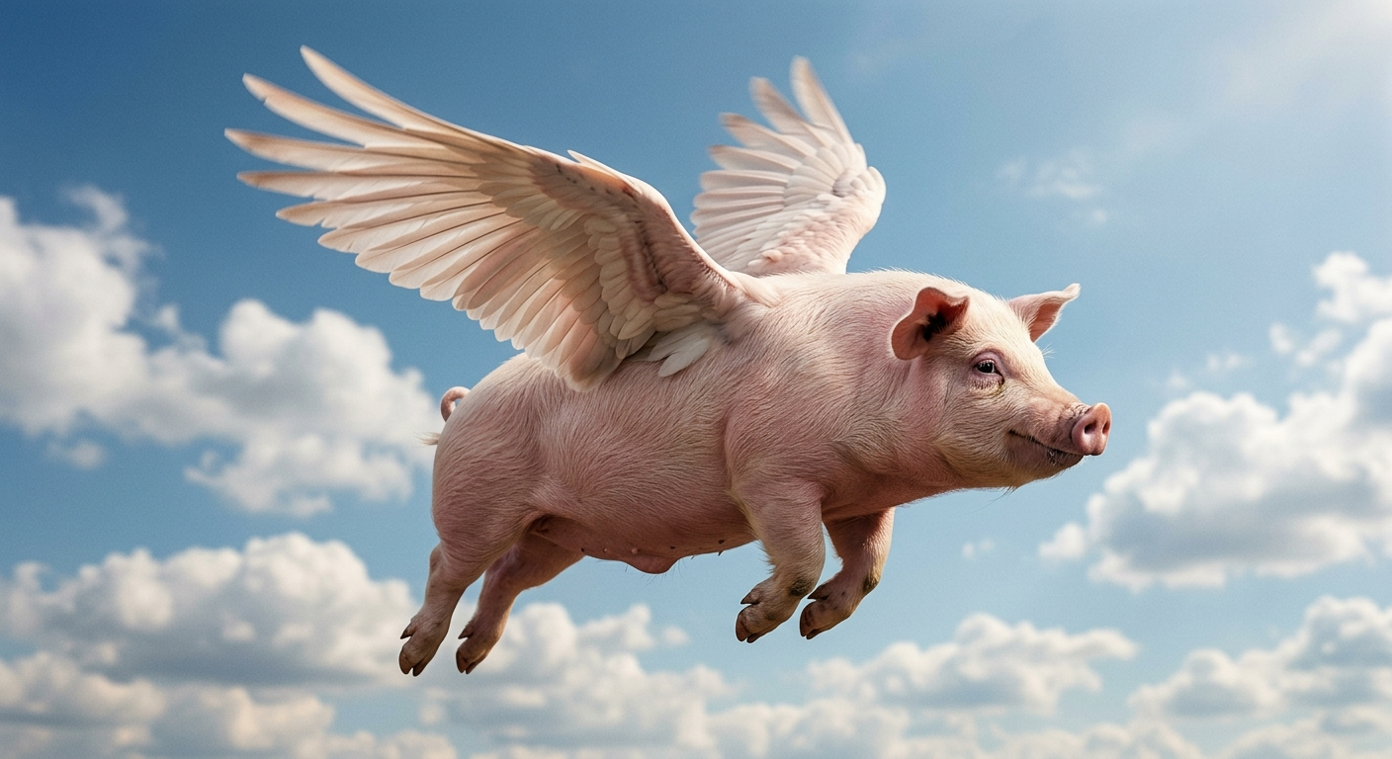
Everyday and colloquial idioms
When pigs fly
A: “Do you think the university will provide us with free internet?”
B: “No way! Forget about it. That will happen when pigs fly!”
Origin: This is a Scottish proverb. Since pigs are heavy animals that cannot fly, it was used to describe something that will never happen.

Slide 18
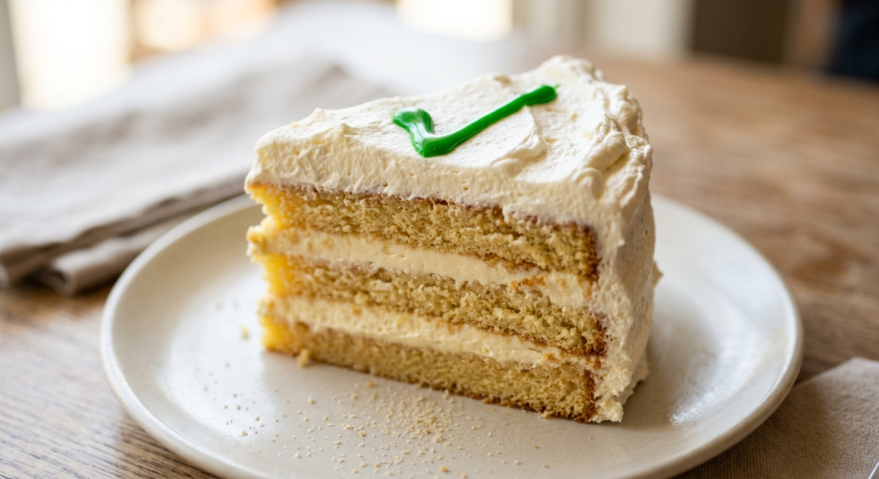
Everyday and colloquial idioms
Piece of cake
Don’t worry about the exam; for you, it’s a “piece of cake”.
Origin: This phrase comes from 19th-century “cake-walk” competitions in the US, where a cake was given as a prize for the easiest or most graceful performance.

Slide 19

Chapter IV
Literary Idioms

Slide 20
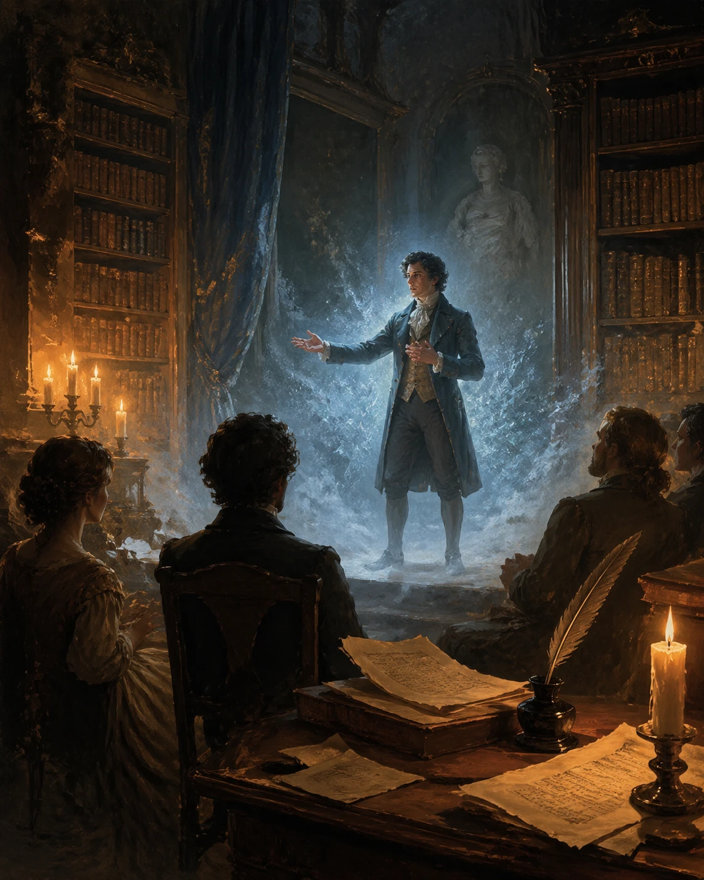
Literary idioms
Have you ever heard someone say:
”BREAK THE ICE”?
Where do you think this expression comes from?

Slide 21

Literary idioms
Idioms inspired by Famous Stories and myths:
1
Break The ice
2
Wild-Goose Chase
3
Trojan Horse
4
Big Brother
5
Pandora’s Box

Slide 22



Overview of Literary idioms
They carry cultural meaning, historical context and make speech richer and expressive.
Academic writing, storytelling , movies , daily conversations and media.
Idioms that came from novels, plays myths and famous literary works.
Where are Literary idioms comes from?
Why are they important?
Where do we use them?

Slide 23
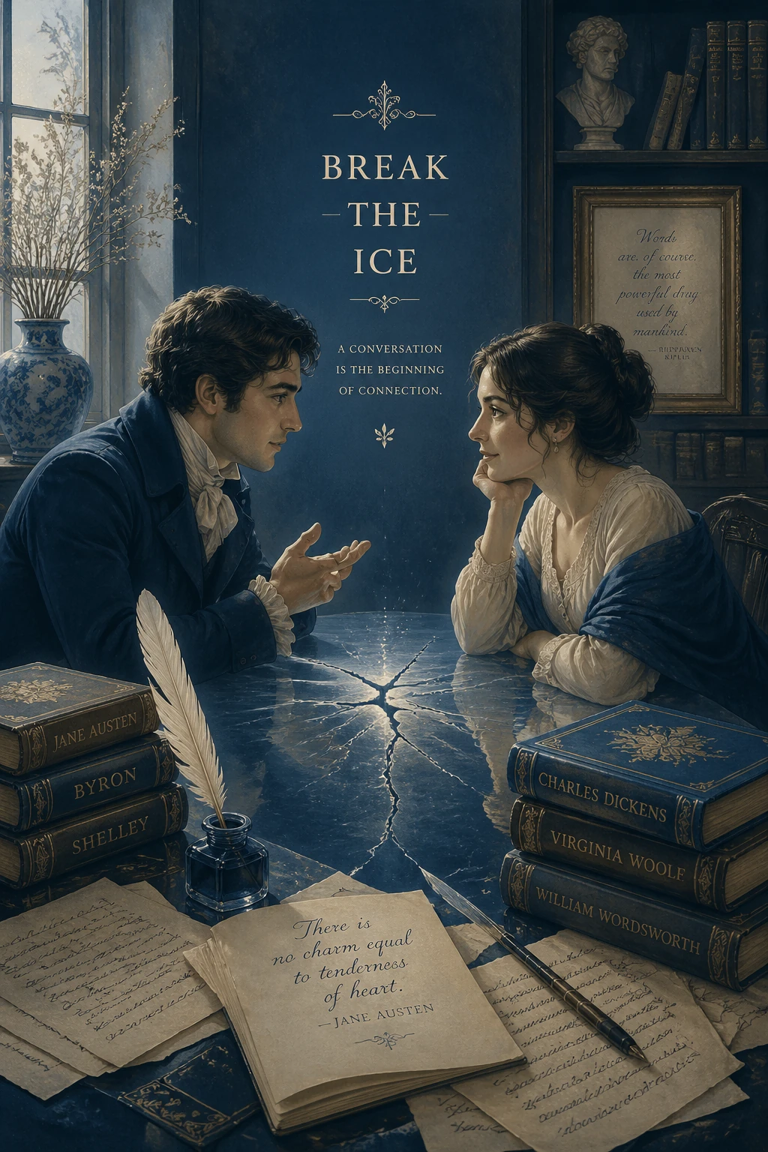
Idiom I
Break the ice
Meaning:
Start a friendly conversation in an awkward situation.
Example:
He told a joke to break the ice at the meeting.
Origin
William shakespeare

Slide 24
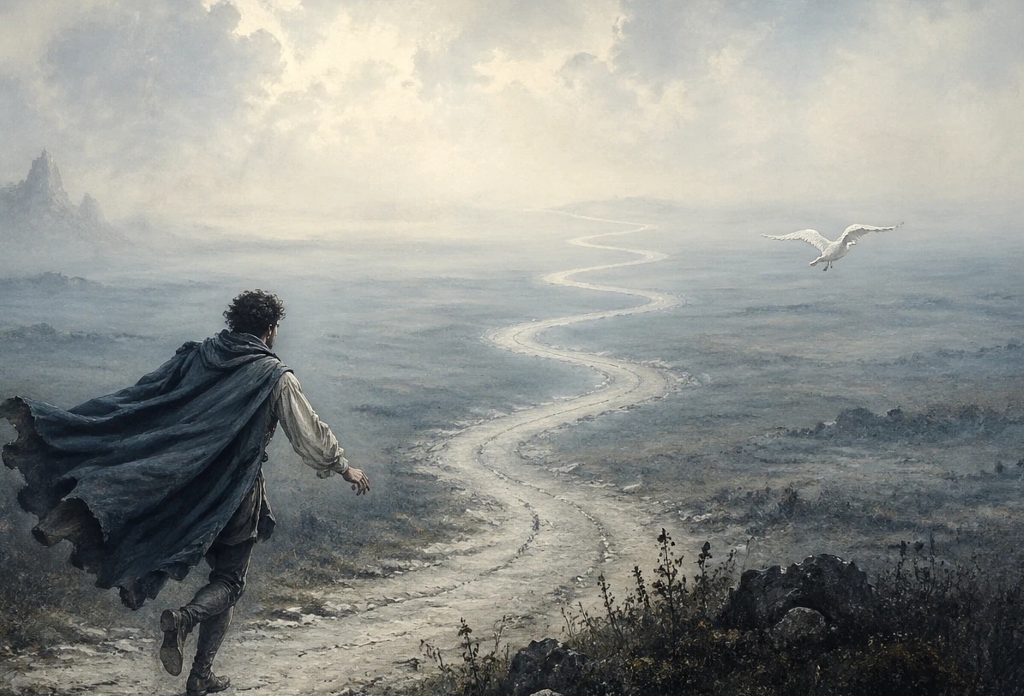
Idiom II
Wild-goose chase
1
Meaning
A useless or hopeless search.
Example
2
Looking for that address
turned into a “wild-goose chase”.
Origin
3
Shakespeare
-Romeo and Juliet-Act2 , scene4

Slide 25
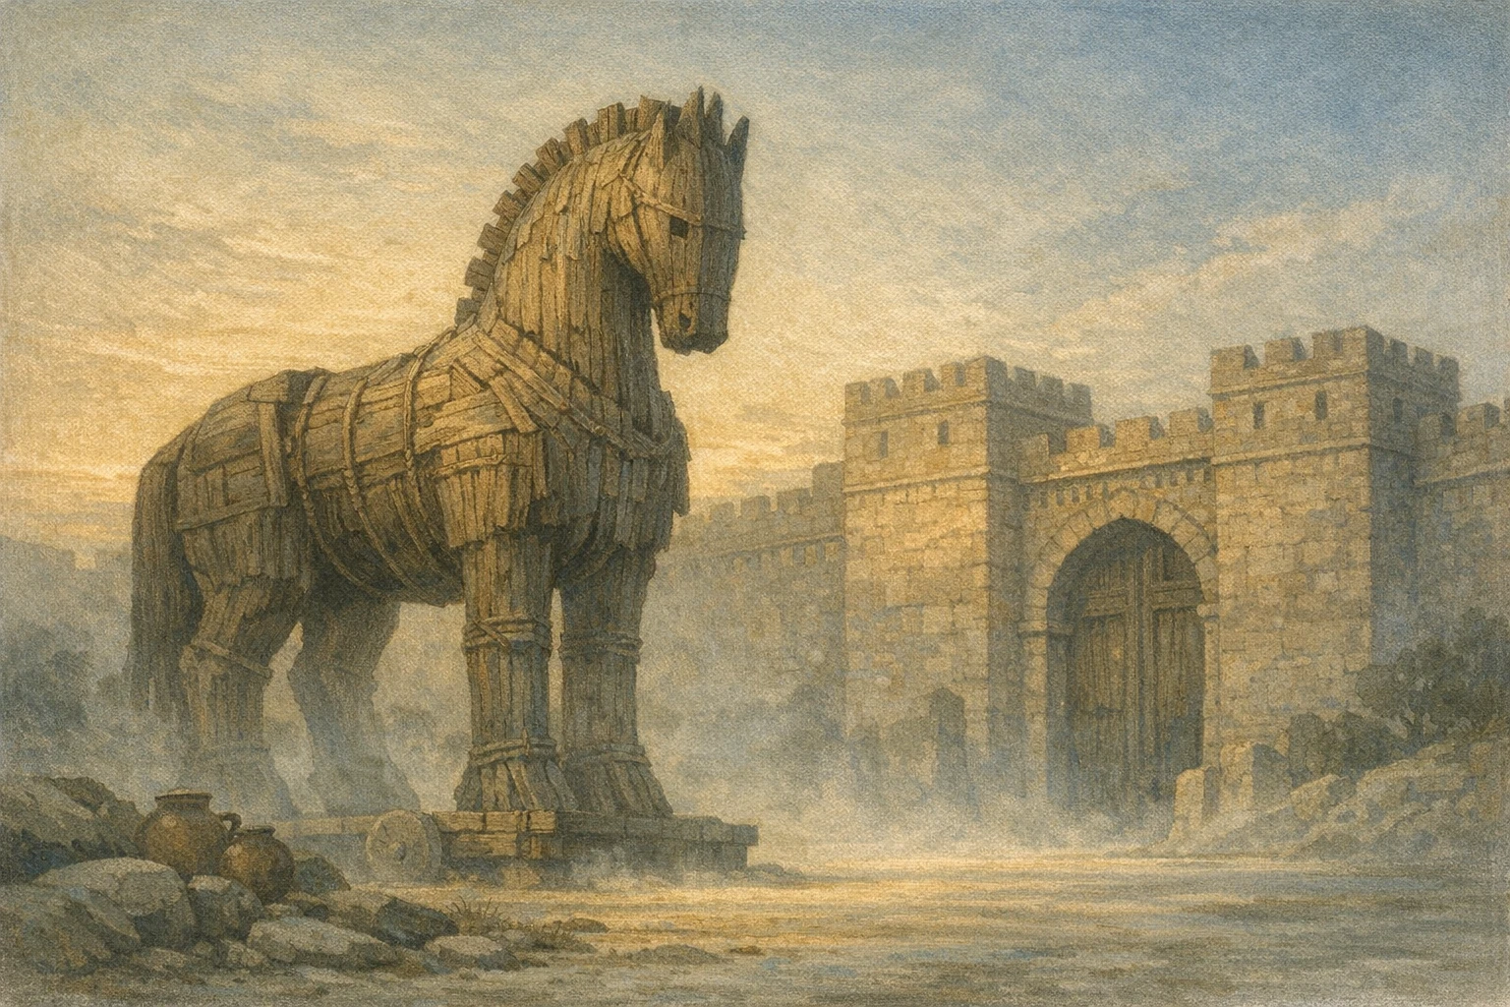
Idiom III
Trojan Horse
Something that looks harmless but hides danger.
Example
The new feature seemed helpful, but it was a ”trojan horse” that secretly collected users’ data.
Origin
Greek mythology -Homer. The Odyssey , Book8

Slide 26

Idiom IV
Big Brother
Meaning
A powerful authority that constantly watches people.
Example
Some people worry that technology is becoming “Big Brother”.
Origin
Orwell, George. Nineteen Eighty-Four. Secker & Warburg, 1949.

Slide 27
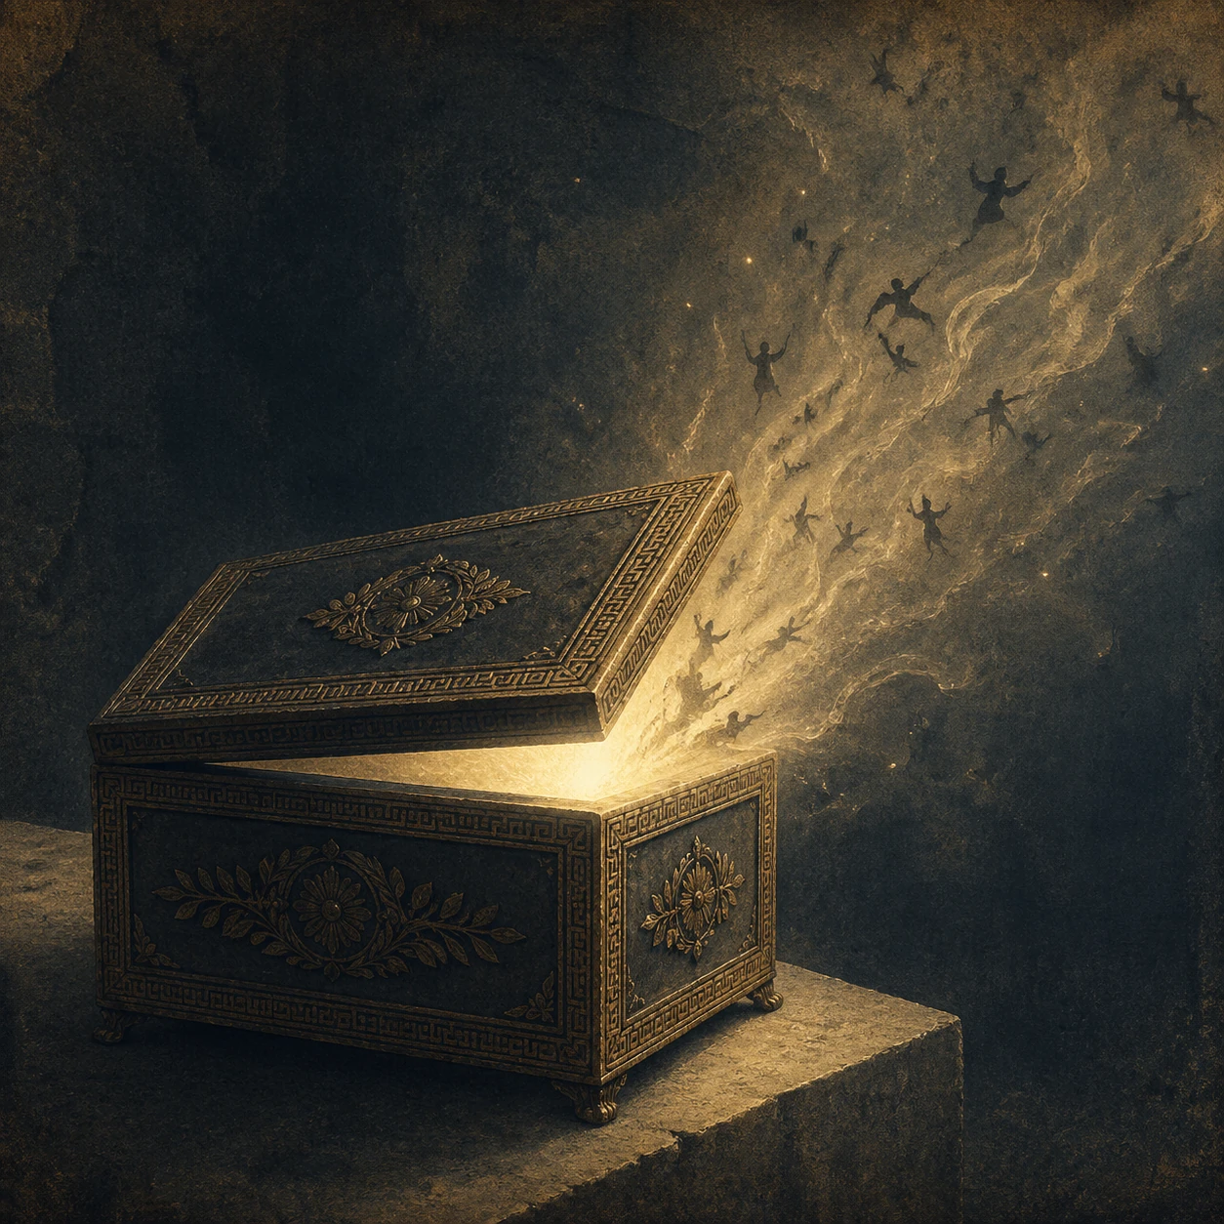
Idiom V
Pandora’s Box
Meaning
An Action that causes many
unexpected Problems.
Example
Changing that rule opened a
pandora’s box of new problems.
Origin
Greek mythology Hesiod.
Works and Days, lines 60–105.

Slide 28
The Enduring impact of Literary Idioms
Enriching Language:
Critical thinking
Literary Idioms add depth ,
nuance and expressive
power to communication
making it more vivid and engaging
Understanding these Idioms requires and fosters analysis of texts and contexts.
Key takeaways
Historical Connection:
Global Communication
They link us to the rich history of
Literature , reflection the values, ideas
and societal norms of
their time.
Proficiency in Literary Idioms
enhances understanding in
academic and professional
English-speaking environments.

Slide 29

CHAPTER V
Academic Idioms

Slide 30
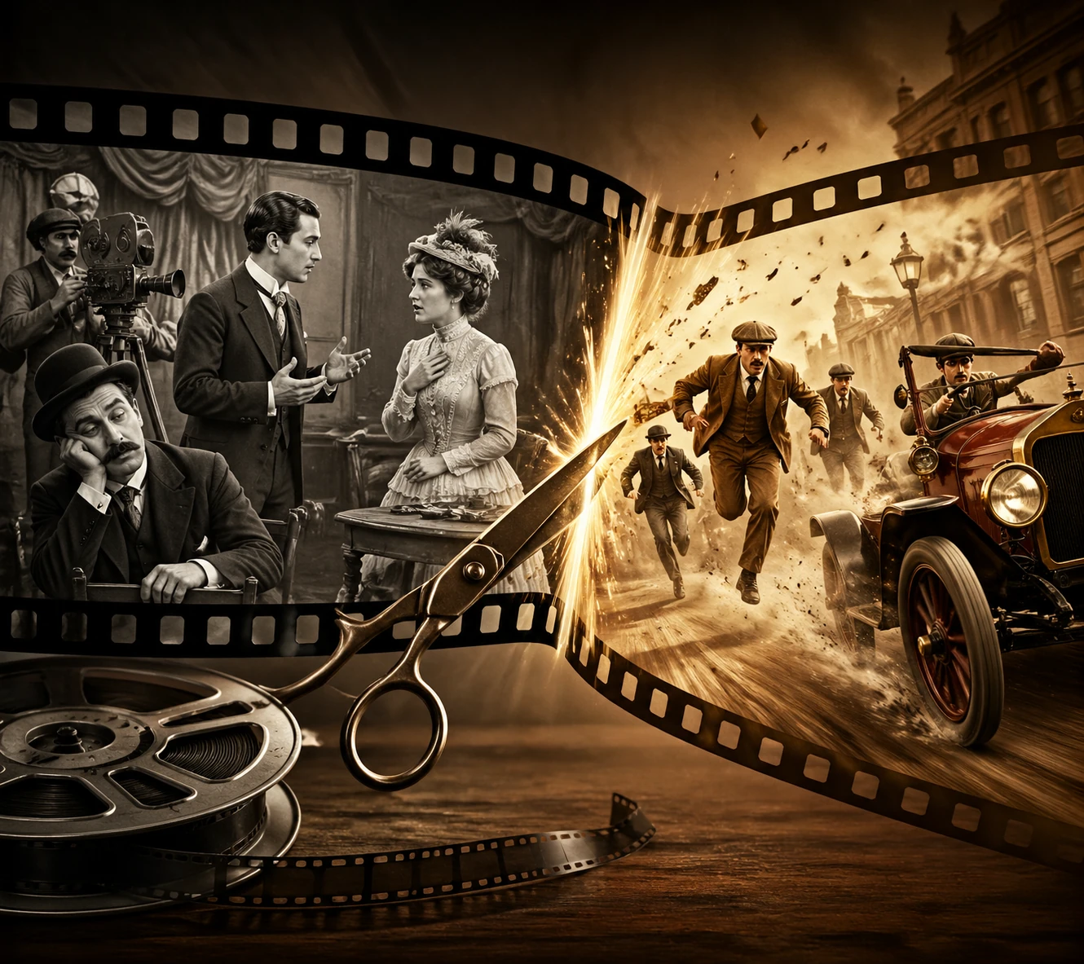
Cut to the chase
Definition: To get straight to the main point and leave out unnecessary details.
Etymology & Origin: This idiom originates from the silent film era in the 1920s.
Films often featured dramatic or romantic storylines that eventually led to an exciting chase scene. Studio executives or directors would use the phrase "cut to the chase" to tell editors to skip the boring dialogue and get straight to the action sequence.

Slide 31
Examples :
If the professor cuts to the chase, we will finish the seminar before noon.
We have been discussing this theory for hours, so let's finally cut to the chase.
Students are often asked to cut to the chase when writing the abstract of their thesis.
By the time the lecture ends, she will have cut to the chase regarding the final exam questions.
Cutting to the chase during a complex defense session saves the committee a lot of time.

Slide 32

Throw in the towel
Definition: To give up or admit that you cannot succeed in something you are trying to do.
Etymology & Origin: This phrase comes from boxing. Many years ago, if a boxer was losing badly and taking too many hits, his coach would literally throw a towel into the boxing ring. This was a clear sign to stop the fight and admit defeat.

Slide 33
Examples :
You may have to throw in the towel and drop the physics class
before it completely ruins your GPA.
If I were you, I would not throw in the towel on my thesis just because
of one bad review from the professor.
While I was throwing in the towel and packing my bags to
leave the library, my classmates were still trying to solve the math problem.
I used to throw in the towel whenever a programming assignment got
too difficult, but now I ask my professors for help.
If I fail this midterm, this time next week I will be throwing in the towel
and changing my major.

Slide 34

Learn by rote
Definition: To memorize something by repeating it over and over again, without really understanding what it means.
Etymology & Origin: The word "rote" dates back to Middle English in the 14th century. While its exact origins are uncertain, linguists believe it likely derives from the Latin word "rota" meaning "wheel" This refers to the mechanical, repetitive, wheel-like nature of this learning method.

Slide 35
Examples :
Medical students rarely succeed if they only
learn by rote without understanding human anatomy.
We shouldn't have learned the Spanish vocabulary by rote, because now
we can't use the words in actual conversations.
My presentation partner, who usually learns everything by rote,
completely forgot his lines when he got nervous.
By the time the open-book exam started, I realized I had learned
the entire textbook by rote for absolutely no reason.
If she hadn't tried to learn the physics formulas by rote,
she would have passed the difficult midterm.

Slide 36
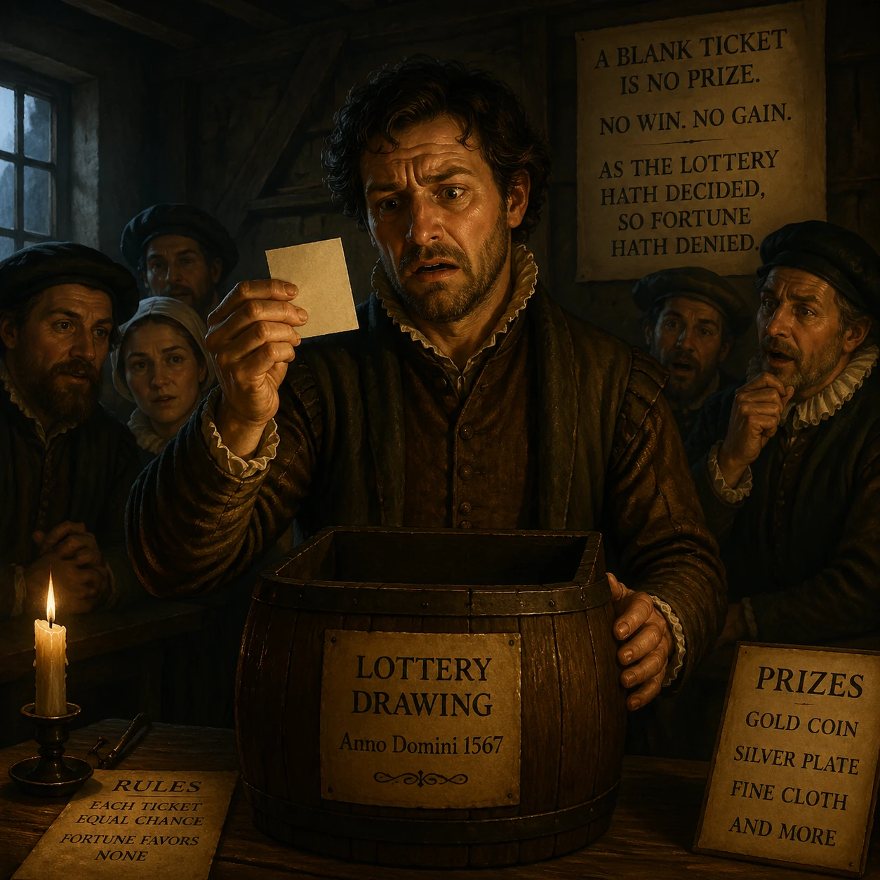
Draw a blank
Definition: To be unable to remember something, or to get no results when looking for an answer.
Etymology & Origin: This phrase originates from 16th-century English lotteries, specifically during the reign of Queen Elizabeth I. Two boxes were used in the draw: one containing the participants' names and another containing prize slips. Most of the prize slips were actually blank. If someone's name was pulled alongside a blank slip, they "drew a blank" and won nothing.

Slide 37
Examples :
Examples :
When the professor asked me about my research
methodology in front of the class, I completely drew a blank.
I am going to draw a blank if I don't get at least
six hours of sleep before tomorrow's oral defense.
Rarely do I draw a blank during history quizzes,
but yesterday's dates were impossibly confusing.
Despite studying in the library all weekend,
I have drawn a blank on every single question of this test!
Having drawn a blank during the first round of the debate,
the law student felt incredibly embarrassed.

Slide 38
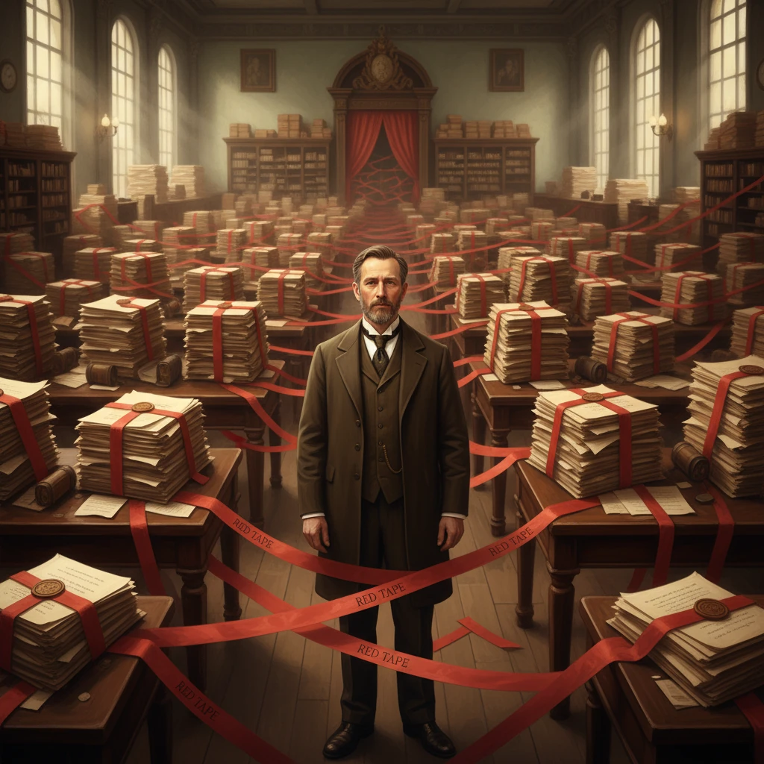
Red tape
Definition: Too many official rules and unnecessary paperwork that make it hard to get things done quickly.
Etymology & Origin: In the 16th and 17th centuries, the British Empire and other European administrations bound official government documents, legal files, and dossiers with red cloth tape. Dealing with these matters required untying the red tape, which eventually became a lasting metaphor for tedious bureaucratic procedures.

Slide 39
Examples :
I wish there wasn't so much red tape involved in applying
for the university's international exchange program.
The funding approval for the new science lab has been
delayed by ridiculous bureaucratic red tape.
Not only does the university's red tape frustrate the students,
but it also discourages potential researchers from joining the faculty.
Despite the endless red tape at the admissions office,
she managed to secure her scholarship.
Dealing with all this red tape just to register for a
simple elective course must be exhausting for freshmen.

Slide 40
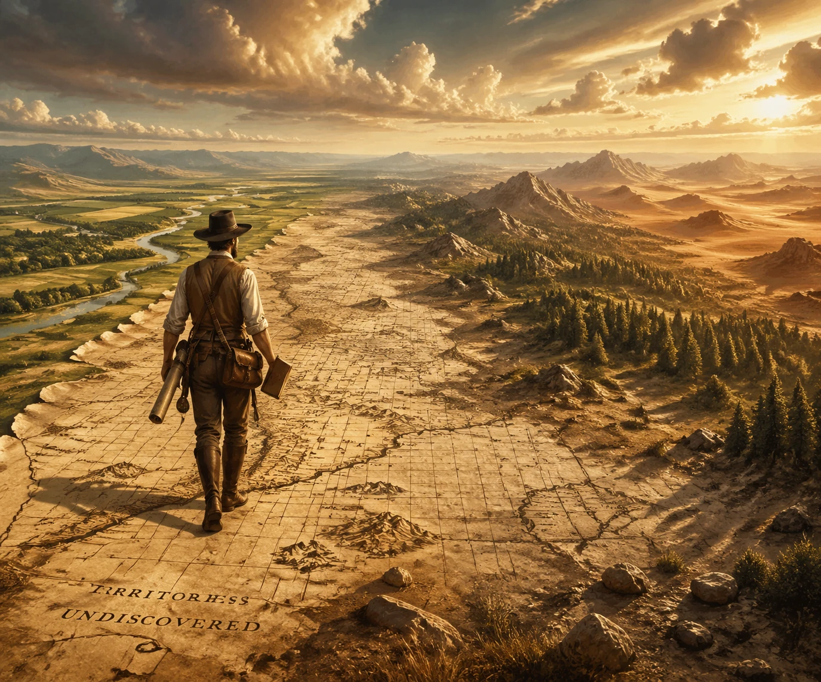
Cover a lot of ground
Definition: To talk about or deal with many different topics and a lot of information in a short amount of time.
Etymology & Origin: Originally, in the 19th century, this phrase was used literally to describe travelers, explorers, or fast horses that physically traveled across a vast distance. By the 20th century, it evolved into a metaphorical expression used in academic and everyday contexts to describe a meeting, book
or lecture that addresses a large amount of information.

Slide 41
Examples :
Next week, the visiting professor is covering a lot of ground in his
intensive two-hour workshop.
The genetics syllabus was so dense that we had to cover a lot of ground
in every single lecture.
To cover a lot of ground before the finals,
the study group meets in the campus cafe every evening.
The intensive summer semester requires you
to cover more ground than in any other regular term.
If the lecturer hadn't canceled two classes last month,
we would be covering less ground right now
instead of rushing through the chapters.

Slide 42

CHAPTER VI
Conclusion

Slide 43
Learning English By idioms
1. Identify useful English idioms (through online research, textbooks, AI tools, or any other available method).
2. Research the history and origin of each idiom.
3. Find several examples that show how the idiom is used in real contexts.
4. Consult English–English dictionaries to look up the idiom (you may also request its English definition from an AI tool) and study the definitions thoroughly.
5. Analyze the grammar and vocabulary in each example.
6. You can also create an image or a short story for each idiom to help you remember it more easily and for a longer time.
By doing this, you'll not only learn a practical idiom but also expand your vocabulary and improve your command of English grammar!

Slide 44
Which Experession from today do you think
you’ll actually use in real life-and why?

Slide 45
English Sources
Cambridge Dictionary Oxford Advanced Learner’s Merriam.
Webster Dictionary Collins English Dictionary.
Oxford Dictionary of Idiom.
Brewer’s Dictionary of Phrase and Fable.
Phrases.org.uk (The Phrase Finder).
“The Handbook of Figurative Language” (Routledge Handbook) .
Idioms: Processing, Structure and Interpretation — by Seana Coulson (Academic Press).
Figurative Language and Thought — by Albert N. Katz (Oxford University Press)
Metaphors We Live By — Lakoff & Johnson (University of Chicago Press).
McGraw‑Hill’s Dictionary of American Idioms and Phrasal Verbs.

Slide 46
Thank you

